Slide 1
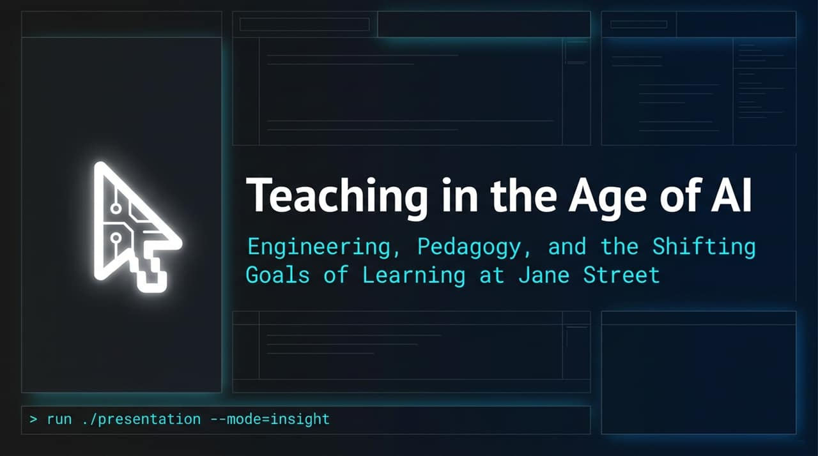
Notes:
Welcome, everyone. Today, we're diving into a fundamentally crucial topic for modern software organizations and technical educators alike: how software engineering education must adapt in an era defined by generative AI.
Look at the pseudocode on this slide. It outlines a core dilemma we face today:
OCaml
cost_of_plausible_PR = 0; (* AI writes it instantly *)
cost_of_verification = MAX; (* Human must reverse-engineer intent *)
For decades, the primary bottleneck in software engineering was authoring code—getting syntactically correct, performant code written and committed. But today, Large Language Models have pushed the cost of generating plausible-looking pull requests down to zero.
However, generating plausible code is not the same as generating correct, maintainable, and secure system architectures. As authoring becomes trivial, the bottleneck shifts entirely to human comprehension and verification. Humans must now read, reverse-engineer, test, and validate AI-generated pull requests.
At Jane Street, where correctness and performance carry immense real-world weight, this shift has forced us to fundamentally rethink how we onboard, teach, and assess engineers. Over the next 15 slides, we’ll examine how engineering pedagogy must pivot from focusing on code generation to building deep mental models.
Teaching in the Age of AI: Learning Goals and the Goals of Learning
https://www.youtube.com/watch?v=qN6OM1IzjIE

Slide 2
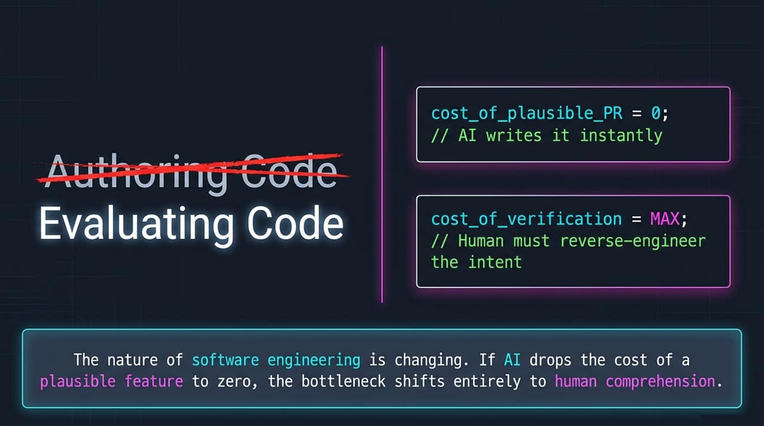
Notes:
To understand Jane Street’s approach to pedagogy, you first need to understand our unique technological stack.
We don't operate like a standard Silicon Valley shop.
OCaml Dominance: Our primary production language is OCaml, a specialized, statically typed functional programming language. Very few new hires come in with production-level OCaml experience.
Iron Version Control: Instead of standard Git/GitHub Web interfaces, we rely on Iron, an internally developed, 25-year-old alternative universe for code review and release management.
Bonsai UI Framework: We use Bonsai, our proprietary functional UI framework for incremental computing.
Custom Python Integration: Data science and research rely on bespoke, highly customized internal Python integrations.
Because of this proprietary, specialized environment, virtually no one walks in knowing how to work here on Day 1.
At Jane Street, education isn't an HR onboarding activity—it is a mandatory engineering infrastructure layer. If our internal educational pipelines fail, our engineering throughput halts. In the AI era, training people to navigate specialized internal ecosystems requires even greater intent, because public AI models are trained on public code bases, not our internal abstractions.

Slide 3
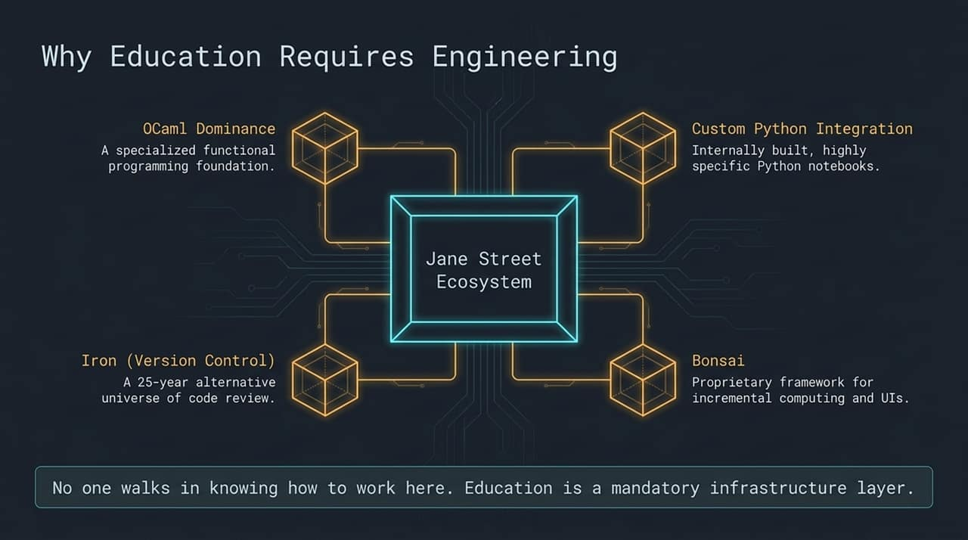
Notes:
How do you design a curriculum for such a specialized tech stack in a rapidly moving AI landscape? You build a 50/50 Hybrid Model for your educators.
At Jane Street, our technical instructors are split down the middle:
50% Software Engineer: Instructors spend half their time actively writing OCaml in production, maintaining internal editor infrastructure, and directly experiencing the toolchain's friction points.
50% Educator: The other half is spent designing onboarding curricula, running specialized teach-ins, and directly mentoring early-career engineers.
Why is this 50/50 split essential? If educators only teach, their knowledge becomes static and detached from real-world codebase changes. If engineers only code, pedagogical expertise gets lost, and teaching becomes an afterthought.
This hybrid structure creates Credible Pedagogy. When an instructor explains how to debug a subtle type error or how to utilize AI code assistance effectively within our toolchain, they aren't giving theoretical advice—they are drawing from their own production commits made earlier that week.

Slide 4
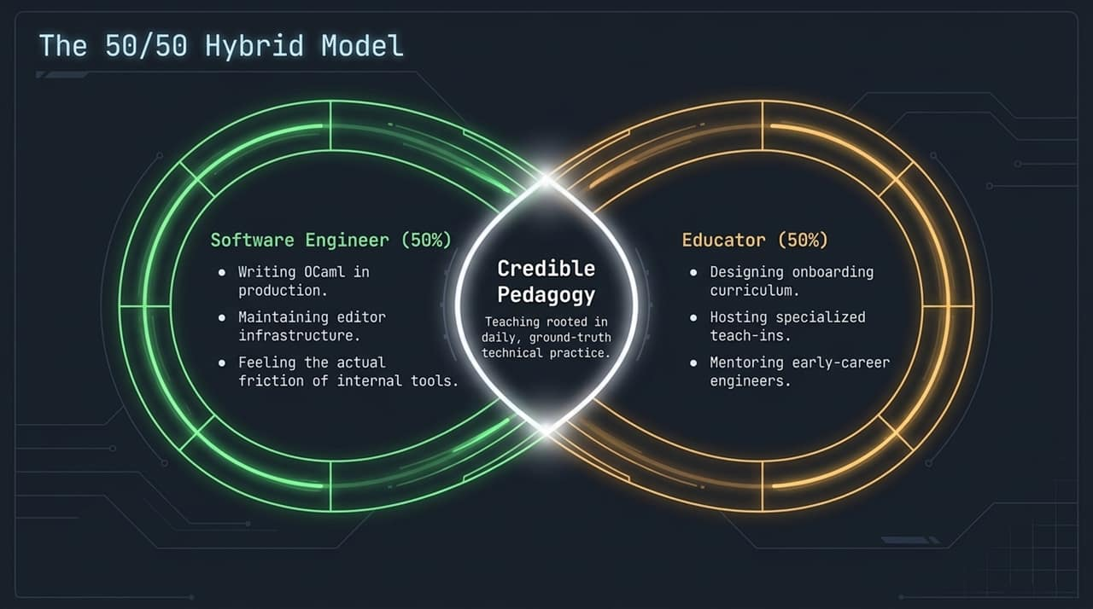
Notes:
While much of the modern tech industry is shifting toward browser-based UIs and web consoles, Jane Street maintains The Text Editor (Emacs, VS Code, Neovim) as the absolute center of gravity for developers.
Our ecosystem integrates directly into the editor interface:
Iron Code Review: Code review comments (CRs) are placed, read, and addressed inline directly inside the text editor.
OCaml Language Server: Delivers high-performance type lookups, jump-to-definition, and real-time type checks directly as you edit.
Version Control: Complete feature branch management happens in-editor without touching a web interface.
The Pedagogy Connection: When introducing AI tools to developers, we do not throw them into detached web chats or separate AI interfaces. AI integration must respect and live inside this text-editor-centric environment. Maintaining a unified, text-editor-centered ecosystem ensures that engineers retain fast feedback loops and key keyboard-driven workflows without context-switching.

Slide 5
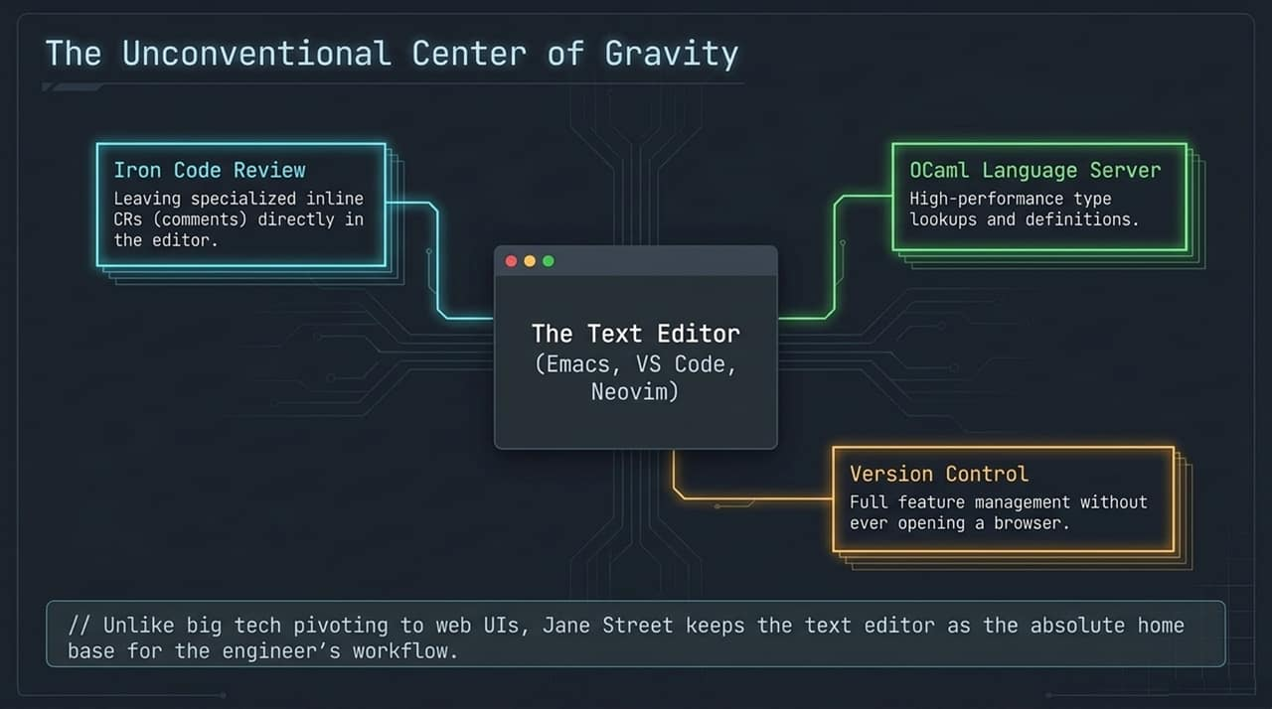
Notes:
Let's look at how the cognitive load of engineering has fundamentally shifted between the Pre-AI Era and the AI-Augmented Era.
1. Authoring Code:
Pre-AI: Authoring took high effort. As you slowly typed code, line by line, you naturally constructed a mental model of the software’s structure.
AI Era: Authoring takes near-zero effort ('Vibe coding'). Entire functions or modules are produced near-instantly.
2. Verifying Code:
Pre-AI: Moderate effort. You wrote it, so you generally understood its execution path; testing verified boundary cases.
AI Era: High effort. Engineers must hunt for subtle, uncanny bugs buried inside syntactically smooth, highly plausible code generated by an AI.
3. Building Mental Models:
Pre-AI: Formed naturally during the authoring process.
AI Era: Mental models must now be awkwardly reverse-engineered by reading finished blocks of code generated by a machine.
Key Takeaway: If an engineer defaults to instant AI code generation, they lose the passive mental-model construction that used to happen during manual coding. Educators must now deliberately design exercises that teach engineers how to build mental models without relying on manual typing as the sole learning vehicle.

Slide 6
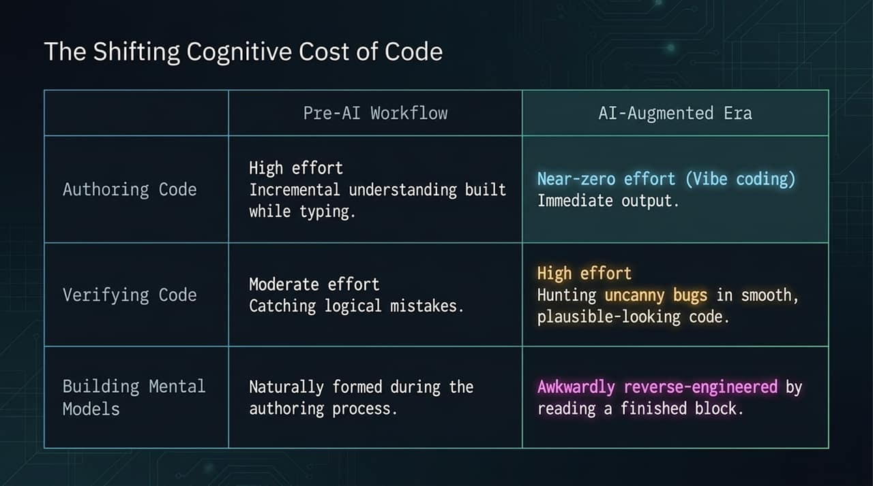
Notes:
Educational psychology teaches us that learning requires cognitive struggle. A student must actively struggle through a problem to build neural pathways and retain complex concepts.
Generative AI acts like an infinitely patient genie. It will gladly solve any problem given to it instantly.
Look at this Venn diagram:
Historically, there was a sweet spot: problems that were Tractable for Beginners but Non-trivial enough to force learning.
In the AI era, LLMs instantly solve almost every standard beginner-level problem. The overlap between 'good for a human learner' and 'hard for an AI to one-shot' is rapidly shrinking toward zero.
If a novice engineer relies on the AI genie to solve every beginner problem, they bypass the required cognitive friction. They reach an answer without acquiring the underlying understanding, leading to a long-term educational crisis when confronted with novel, complex system failures.

Slide 7
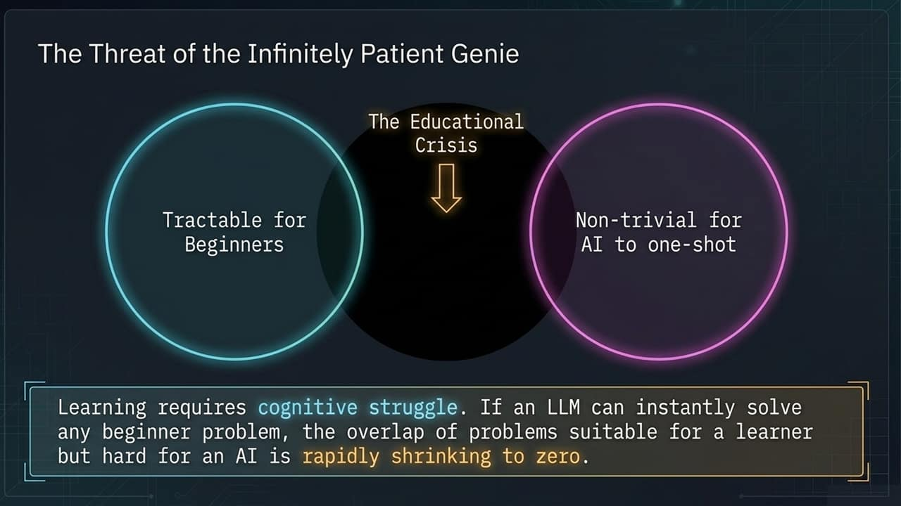
Notes:
How do we combat this 'Infinitely Patient Genie' problem? We practice Strategic Withholding of Affordances.
Instead of giving learners unrestricted access to full code-generation prompts, we tune AI tools—such as custom-configured Claude Code styles—to act as tutors rather than auto-completers.
Look at the code sample on this slide:
OCaml
let test_property input =
(* System setup code generated... *)
(* TODO (Human): Implement property-based test logic here. *)
(* [LLM Paused. Awaiting human implementation.] *)
Notice what happened here: The AI scaffolded the boilerplate, system setup, and types, but intentionally paused right before the critical logic.
By withholding the full solution, we force the developer to engage in the specific cognitive task required to learn property-based testing. We leverage AI to eliminate busywork while strictly guarding the learning moments.

Slide 8
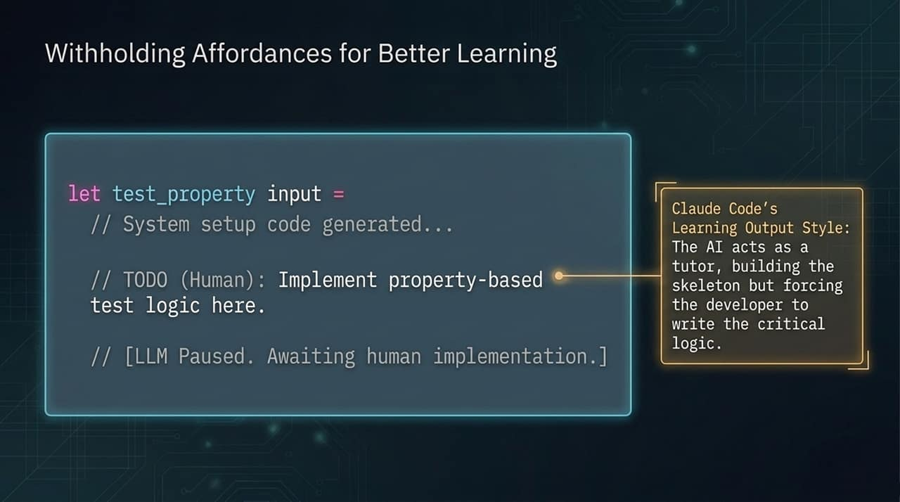
Notes:
To teach effectively in an AI-dominated world, we must elevate how we define Learning Goals. Vague learning objectives fail when AI can generate superficial proofs of work.
Consider this contrast:
Weak/Vague Goal: Students will understand property-based testing.
Critique: This is unmeasurable. It exists only inside the student's head, and a student can easily paste an AI response to fake comprehension.
Actionable/Observable Goal: Students will be able to write a property-based test for a nested record type input.
Critique: This is observable, specific, and dictates exactly how to design course exercises and evaluation criteria.
When designing curricula, every goal must be framed around observable performance. What concrete action must the developer execute that proves real understanding, independent of an AI prompt?

Slide 9
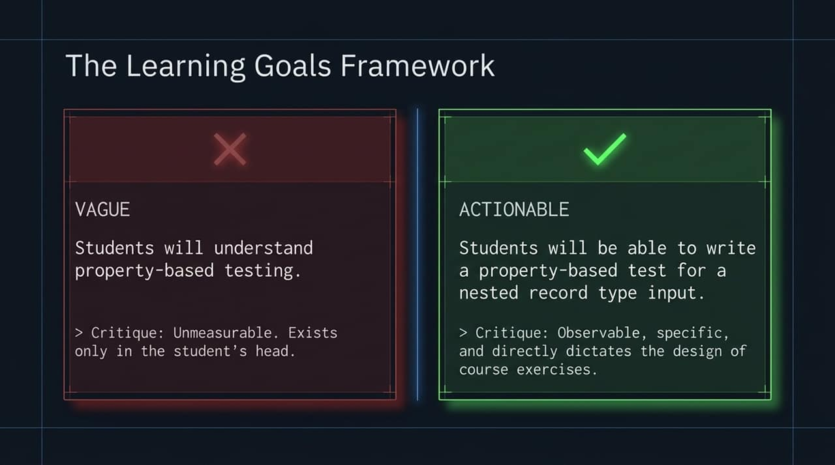
Notes:
When onboarding engineers into a complex ecosystem like Jane Street, cognitive overload is a huge risk. Human working memory is strictly limited.
To prevent overload, we sequence tool delivery across four distinct phases:
Language Syntax: Introduced first via isolated browser snippet boxes. This completely strips away environment setup and editor complexity so the developer can focus strictly on OCaml semantics.
The Editor: Once syntax basics are solid, developers transition into the text editor, mastering keystrokes, navigation, and language server feedback.
Version Control: Next, we layer on Iron VCS, teaching developers how code branches, feature trees, and review comments flow.
Integration: Finally, developers build a full client-server bootcamp application that ties syntax, editor tools, version control, and UI frameworks together.
Core Principle: Never introduce a new tool until the foundational tool is mastered. Pushing AI tooling onto a beginner before they understand basic syntax or editor semantics creates an unmanageable cognitive load.

Slide 10
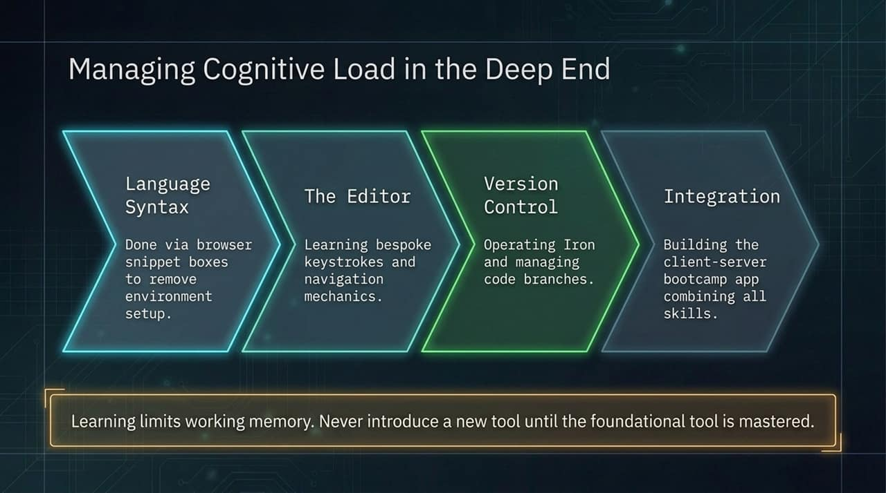
Notes:
Because generative AI can solve standard 4-week intern projects in a single well-crafted prompt, traditional internship evaluations are obsolete. Measuring code production speed no longer measures human talent.
We have completely pivoted our internship program:
Legacy Focus: Manual bulk code writing, completing a self-contained 4-week solo project, and using code generation velocity as the primary hiring signal.
New AI-Era Focus:
Requirement Gathering: Can the intern extract complex, ambiguous requirements from human stakeholders?
Architectural Stewardship: Can they write, defend, and critique Design and Architecture Documents?
Verification & Testing: Can they rigorously test and steward code to production readiness?
We don't grade how fast an intern can produce code; we evaluate how well they steward software through its architectural lifecycle.

Slide 11
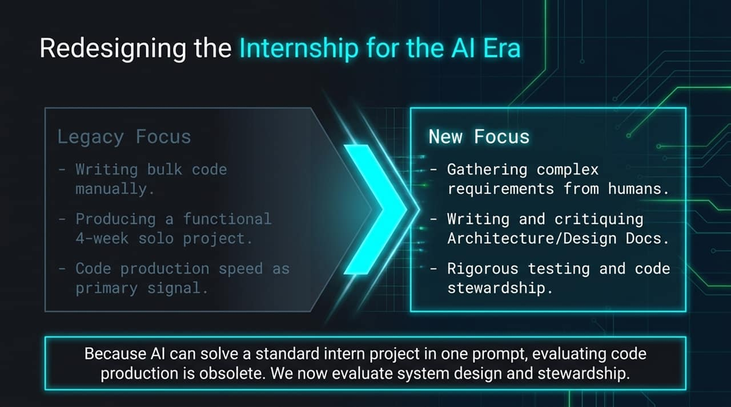
Notes:
Historically, interns spent little time reviewing code; their goal was simply to write it. In the AI era, code review is the primary mechanism for verification and quality control. It now gets a dedicated 3-day intensive training module mid-internship.
Our Code Review Training consists of three steps:
Diagnose: Interns are given pre-made, intentionally flawed features containing hidden logical, performance, or concurrency bugs inserted into an existing codebase.
Calibrate: After conducting their reviews, interns compare their inline comments against a curated Answer Key of ideal code review comments created by senior engineers.
Execute: Interns apply their calibrated skills in real-time by peer-reviewing actual feature commits from their pod-mates.
By making code review a explicit skill, we train interns to catch the exact type of subtle, high-risk bugs that AI generators introduce.

Slide 12
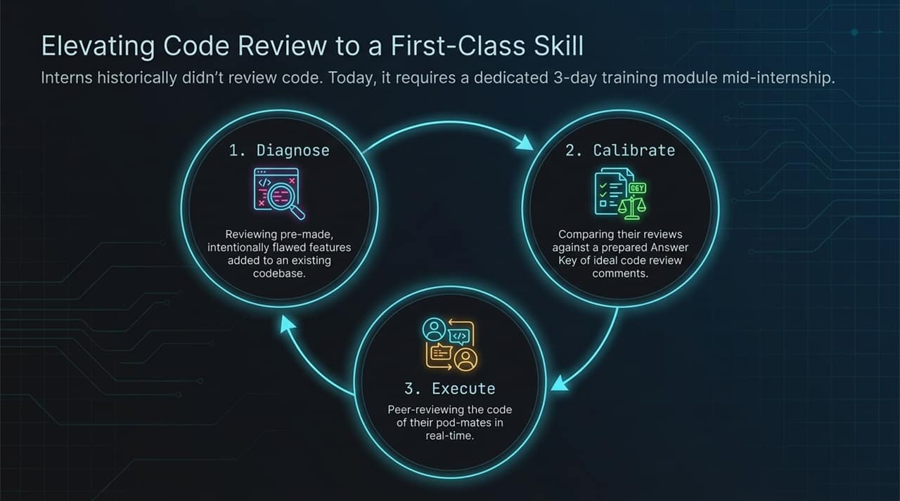
Notes:
To prevent automated complacency—where a developer relies passively on an AI feedback loop—we inject social friction into the curriculum through human-to-human interaction.
We rely on two social structures:
The Pod System: Interns are grouped into pods of four. When an LLM prompt fails or generates hallucinated code, the pod discusses the failure mode and collaboratively devises debugging and testing strategies in real-time.
The Roleplay: Senior full-time engineers act as demanding, ambiguous business stakeholders. Interns must interview them, extract actual requirements, navigate conflicting needs, and verbally justify their system design choices.
AI cannot replicate human social friction. Anchoring learning in collaborative, real-world team interactions keeps engineers grounded, accountable, and deeply engaged.

Slide 13
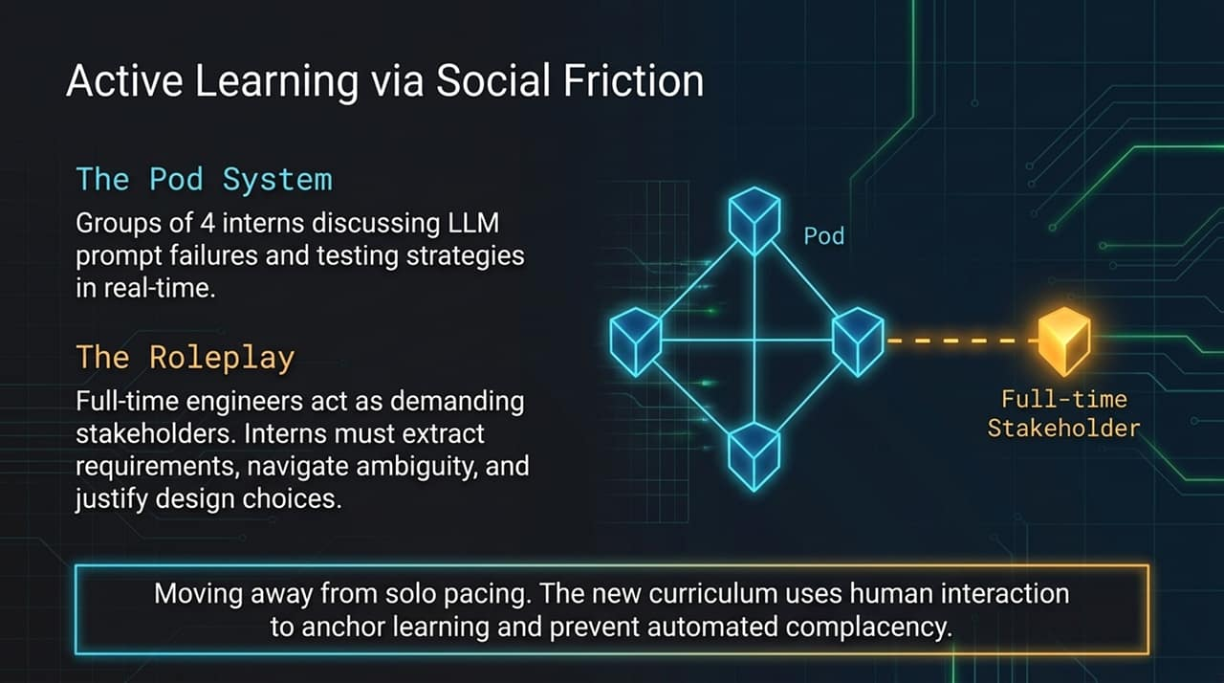
Notes:
In an AI-driven environment, curriculum cannot be static; it must operate as a continuous feedback loop.
Our adaptive loop relies on three pillars:
Update Teaching Models: The optimal ways to prompt, guide, and inspect LLMs change constantly as models evolve. Our curriculum is a living framework updated every few months.
Monitor Telemetry: We track quantitative engineering telemetry. For example, data showed developers were utilizing 'jump-to-definition' more frequently when using AI assistants. This revealed that developers needed better jump-to-definition navigation skills to verify generated code quickly.
Adjust Task Scope: When we observed interns spending too much time manually polishing oversized AI-generated drafts, we scaled project scopes down to emphasize depth over breadth.
By pairing telemetry with classroom observation, we continually refine how we teach.

Slide 14
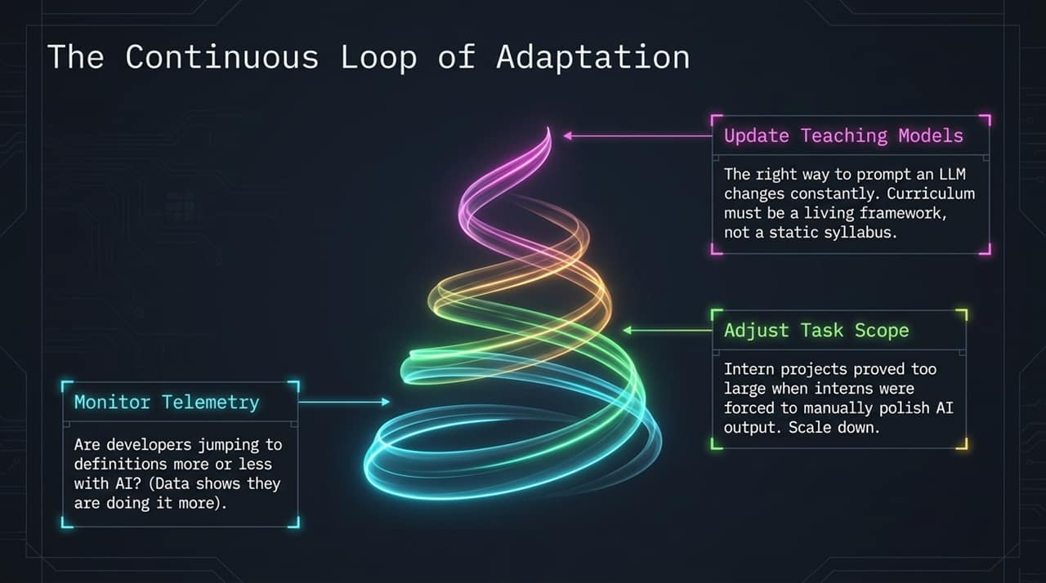
Notes:
If you are looking to adapt your own engineering organization or academic curriculum for the AI era, this slide summarizes our overarching blueprint:
Embed Pedagogy: Adopt the 50/50 Developer/Educator model. Ensure your instructors write production code so they intimately understand actual workflow friction.
Shift the Bottleneck: Stop evaluating developers on raw code production velocity. Build training programs specifically around code comprehension, verification, architecture, and code review.
Define Observables: Replace vague syllabi with observable, specific, and measurable Learning Goals.
Strategic Withholding: Do not let AI become an unconstrained, infinitely patient genie. Custom-configure AI tools to scaffold boilerplate while forcing human developers to solve the critical core logic.

Slide 15
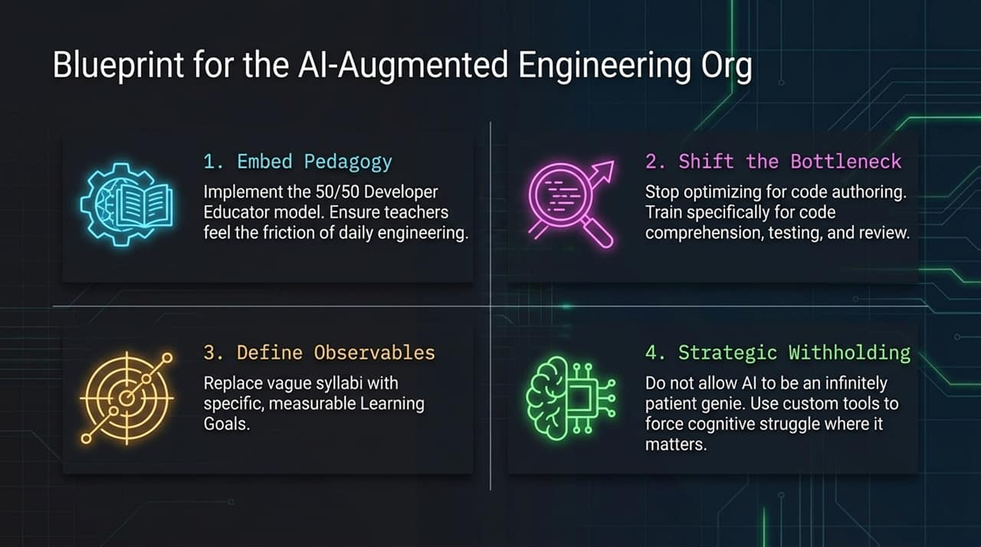
Notes:
This slide provides a visual summary of the mental shift required across the industry.
Image 1 (Brain & Dialogue): Demonstrates the cognitive transition. Software engineering is moving from mechanical syntax execution to high-level architectural reasoning and intent communication.
Image 2 (Human at Machine): Represents stewardship. The human engineer is no longer the manual compiler; they are the operator and validator overseeing automated assembly.
Image 3 (Code Workspace): Highlights the centrality of focused, integrated text-editor workflows over fragmented Web tools.
Image 4 (Magnifying Glass over Code): Represents verification. The primary skill of the modern engineer is critical inspection and deep debugging.
Image 5 (Collaborative Whiteboard): Highlights social friction. Architectural alignment, human requirement extraction, and pod collaboration anchor real-world learning.
Image 6 (Locked AI Access): Symbolizes strategic withholding—controlling AI access points to ensure foundational skills are built before automation is unlocked.
These six images illustrate a single reality: engineering education is moving from authoring production to architectural mastery.

Slide 16
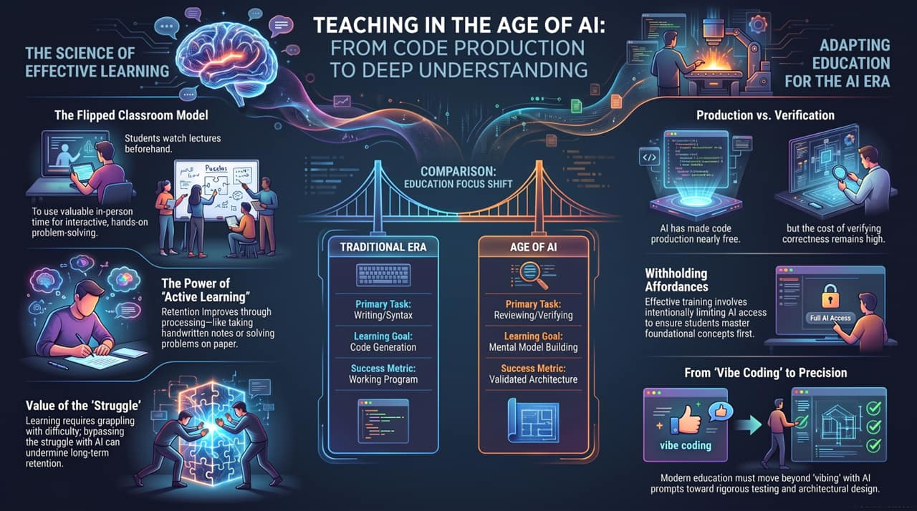
Notes:
To conclude, let’s consolidate the core educational shift driving our pedagogy.
The Science of Effective Learning:
Flipped Classroom Model: Information delivery happens prior to class; valuable interactive time is reserved for live problem-solving and peer review.
Value of the 'Struggle': Bypassing cognitive struggle via instant AI generation degrades long-term skill retention.
Withholding Affordances: Restricting AI access at key learning milestones ensures foundational mastery.
Dimension Traditional Era Age of AI
Primary Task Writing / Syntax Reviewing / Verifying
Learning Goal Code Generation Mental Model Building
Access Model Full Manual / Standard Tools Strategic Withholding / Guided AI
Success Metric Working Program Validated Architecture
Final Word: We must move software engineering education away from 'vibe coding' and unvetted prompts toward rigorous verification, test stewardship, and validated architecture.
Thank you! I will now open the floor to any questions.
Teaching in the Age of AI: Learning Goals and the Goals of Learning
https://www.youtube.com/watch?v=qN6OM1IzjIE

